Slide 1
Creating a Classifier for Dance and Martial Arts Moves
Sophia Wang and Neha Bagalkot

Slide 2
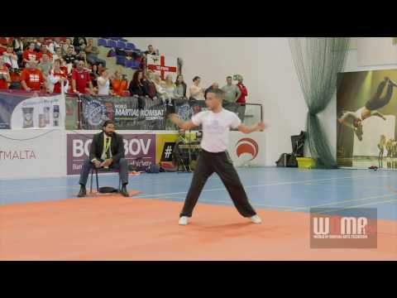
Motivation
Competitions
Improvement
Cost-effective

Slide 3
We will classify dance and martial art moves using only cameras.
Proposal:

